Slide 1

CARLOS LORES & JORGE CURA
3-PLAYER KUHN POKER

Slide 2

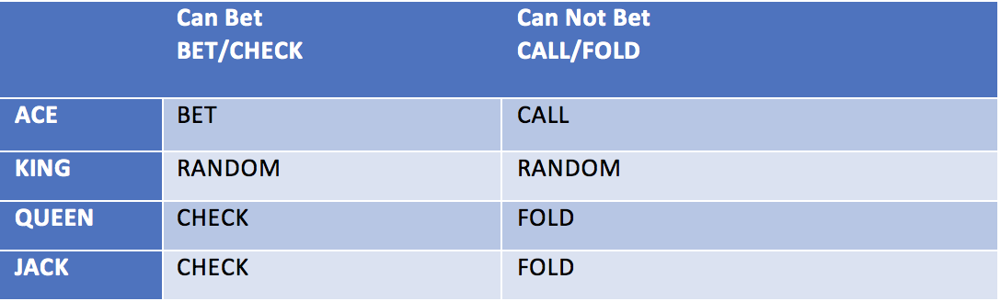

Slide 3
Ace card on Hand, if it can Bet, place a BET.
Ace card on Hand, if it can’t Bet, place a Call.
King card on Hand, if it can Bet, play at Random(BET or CHECK).
King card on Hand, if it can’t Bet, Play at Random(Call or Fold).
Queen card on Hand, if it can Bet, place a Check.
Queen card on Hand, if it can’t Bet, Fold.
Jack card on Hand, if it can Bet, place a Check.
Jack card on Hand, if it can’t Bet, Fold.

Slide 4
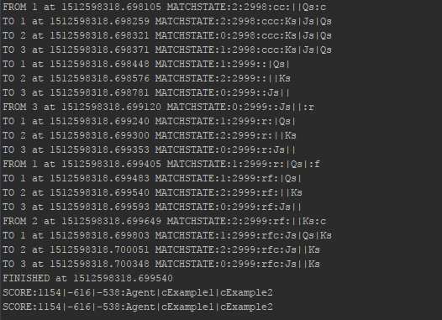

Slide 5
THE END!

